Slide 1
Installation of TC
Presented By S.R.Zameer

Slide 2
Installation of TC
Installation of TC is very simple just download turbo C or C++ and run .exe files
When you install the Turbo C compiler on your system, then TC directory is created on the hard disk and various sub directories such as INCLUDE, and LIB etc. are created under TC.

Slide 3
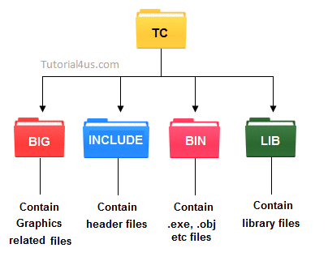

Slide 4
Sub Folders of TC
INCLUDE :Contain the header files of C.
LIB: Contain the library files of C.
BGI: Contain Graphics related files.
BIN: Contain .exe, .obj etc files.

Slide 5
Turbo C For Window(xp, 7, 8)
Previously Turbo C are not work properly on Window 7 and its above versions.

Slide 6
TC Editor
TC Editor is very simple and easy to use; here i will give you all tips related to TC Editor and some shortcut keys related to TC Editor which is very useful at the time of coding. Turbo C is a most common C language compiler.

Slide 7
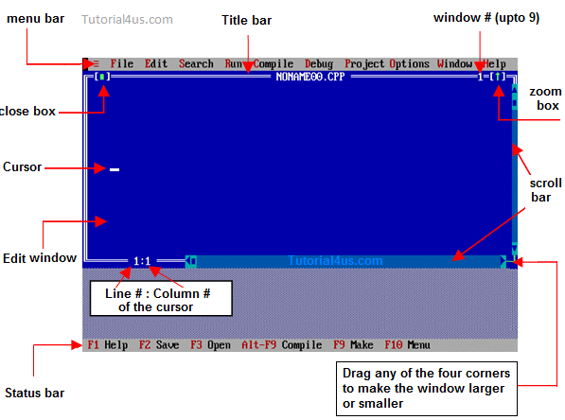
APTECH AKP

Slide 8
IDE Menu Bar
The interface of Turbo C is very simple. When IDE screen appears, the menu bar is activated. It contains various menus such as;
File: This menu contains group of commands used for save , edit , print program, exit from Turbo C editor etc.
Edit: This menu contains group of commands used for editing C program source code. Example Copy, Cut, Paste, Undo etc.

Slide 9
Menus
Search: This menu contains group of commands used for searching specific word as well as replacing it with another one.
Run: This menu contains group of commands used for running C program.
Compile: This menu contains group of commands used for compiling C program.
Debug: This menu contains group of commands used for debugging C program.

Slide 10
Menus
Project: This menu contains group of commands used for opening, closing and creating projects.
Options: This menu contains group of commands used for configuring IDE of Turbo C and setting up directories etc.
Windows: This menu contains group of commands used for opening, closing various windows of IDE.
Help: This menu is used to get help about specific topic of C language. Similarly to get help about a specific keyword or identifier of C.

Slide 11
Shortcuts in TC Editor
Alt + x : Close TC Editor.
Clt + f9 : Run C Program.
Alt + f9 : Compile C Code.
Alt + Enter : Get Full Screen or Half Screen TC Editor.
Clt + y : Delete complete line above the cursor.
Shift + Right arrow : Select Line of Code.
Clt + Insert : Copy.
Shift + Insert : Paste.
Shift + Delete : Delete.

